Slide 1
Verifiable Attribute Based Keyword Search with Fine-Grained Owner-Enforced Search Authorization in the Cloud
They really need a shorter title.

Slide 2
Problem
Searching through encrypted data is difficult
It becomes more difficult when the data is encrypted by the client
Previous work assumes a single contributor model
Notes:
In a single contributor scenario it is necessary to either share a secret key with users or to stay online and generate a trap door (encrypted keywords) (doesn’t make sense once you consider confusion and diffusion) to be searched.
A key used to encrypt the dataset and generate the trapdoors. (they don’t explain this well at all)

Slide 3
Multi-Contributor Systems
It is difficult for a variety of users to contribute to and search the datastore
Fine grained access to the data is a problem
In this situation key management is the primary issue
Asymmetric cryptographic keys are an option
Enrollment and revocation become a nightmare
Notes:
Single key doesn’t work well
Too much complexity, complexity = vulnerabilities.
Encrypting with a public key could work, but it becomes awkward when operating at scale.

Slide 4
ABKS-UR
Inspired by attribute based encryption
Encrypts the index of each with a user defined access policy, defining who can access it
No always online component
Keywords = content of the files
Attributes = user characteristics
Encrypted Search with a whitelist
Notes:
Ciphertext policy attribute based encryption.
Access groups sort of concept, but with encryption.
Proxy and lazy re-encryption techniques free up the user to do other things when handling revocation

Slide 5
Previous work
Secret and Public key crypto
Coordinate matching
Cosine similarity measure
Authorized keyword search = not scalable
APKS, better suited to database tasks.
Notes:
Different similarity measures for symmetric
Previous authorized keyword search methods are not scalable. As the number of users grows the index and search complexity grows. Problem with re-encrypting each index with each public key
APKS (authorized private keyword search), significant communication costs, search time is proportional to the total number of key words. Arbitrary structured data is hard in this model.

Slide 6
Terminology
CP-ABE: ciphertext policy attribute-based encryption
IND-sCP-CKA: Chosen keyword attack under selective ciphertext policy
TA: trusted authority
PKC: public key cryptography
SKC: secret key cryptography (symmetric)

Slide 7
Attribute Based Encryption
Based on public key cryptography.
Attributes are associated with the user’s private key and the access structures with the cipher text.
Public key components exist for each attribute
The encryptor chooses an access structure of attributes
The message is encrypted with the corresponding public key components.
Notes:
Lazy and proxy re-encryption enable revocation
The users secret key are associated with a list of

Slide 8
Attribute Based Encryption
Access structures are defined as a series of AND gates.
Can be extended to allow for proxy based re-encryption.
The ciphertext is only decrypted if the attributes used for encryption satisfy the access structure.
Resistant to collusion attacks.
Notes:
Decisional bilinear Diffie-Hellman assumption
Cheung = AND gate
Yu et al = revocation
Linear relationship between the number of attributes/access control size and the key/ciphertext size, not the number of users.
ABKS-UR utilizes the work of Yu et al. and Cheung et al
Attribute revocation

Slide 9
Design Goals
Authorized Keyword Search
Multiple contributors
Efficient revocation
Verifiable search result
Security goals
Keyword Semantic Security, trapdoor unlinkability,
Notes:
Add more about the security goals and tie them into the threat model
Keyword semantic security: Must be secure against a chosen keyword attack, under the selective cipher text policy model]
Trapdoor unlinkability, can’t distinguish two trapdoors even if they contain the same keyword.

Slide 10
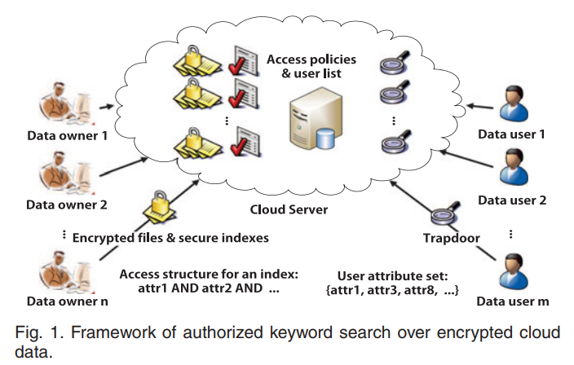
System Model
Entities: Cloud server, data owners, and data users
A trusted authority is assumed to handle key generation and distribution
Data owner generates indexes with access policies before sending them to the server
Notes:
Does not assume encryption with any specific algorithm, therefore flexible to different use cases
(probably could get away with RC4 if you really want to shoot yourself in the foot)

Slide 11
Searching the Datastore
The data user generates a trapdoor for a keyword with their private key and submits it to the server
Coarse grained data set authorization
File level search authorization
Information is only returned if attributes of the trapdoor satisfy access requirements of the secure indexes
Notes:
Course grained authorization is a quick sanity check and a performance optimization to speed up denials.
File level authorization is applied such that only users with permission to access a file can search it for a keyword

Slide 12
Threat Model
Cloud server is honest but curious
It follows the protocol but infers additional information.
Malicious users can collude to access files beyond their privileges using secret keys.
The CS will not collude with revoked users.
Notes:
I find this threat model lacking in detail.

Slide 13
System Setup
Some trusted authority generates the following with a security parameter and a universal set of attributes.
PK, public parameters, or public key
MK, master secret key

Slide 14
Enrollment
When a new user sends a registration request the authority selects a new MK component and a new PK component.
The KeyGen algorithm is called to generate a new secret key for this user.
Server maintains a list of each user’s identity information for each dataset
The CreateUL algorithm creates a user list for a dataset
Notes:
The authorities….

Slide 15
Index Generation
Data owner calls EncIndex to generate a security index for each file before sending it to the server.
Takes in an access policy (GT), the public parameter (PK), and a keyword (w)
Outputs an encrypted index (D).

Slide 16
Trapdoor Generation
Any user can generate a trapdoor for a keyword
A trapdoor is generated using the public parameters (PK), the users secret key (SK), and a keyword (w)
This produces a trapdoor (Q)
Trapdoor unlinkability
Each trapdoor is differentiated with a different random number, so that the server cannot differentiate the two.

Slide 17
Search
The user submits their user ID and trapdoor to the server.
Server checks if that user exists in the list for that dataset.
If the user’s attributes satisfy the access structure in the index then they can access the file.
If there the version of the trapdoor is newer than the index then the index is updated.
If the trapdoor is older than the index then the request is ignored.

Slide 18
Revocation
To revoke a user the secure index are re-encrypted and the remaining user’s keys are updated.
The trusted authority is used to generate a new keyset.
This new keyset is then used to re-encrypt the dataset.
Lazy re-encryption allows for the version of the re-encryption keys to be greater than the system version
Once the keys are updated the user is struck from all relevant user lists

Slide 19
Conjunctive keyword search
It is possible to return searches with multiple keywords.
Multiple values are contained in a single trapdoor.
Claimed to have the same efficiency as the single keyword version.
Notes:
Regardless of the number of additional keywords.

Slide 20
Authenticated search
A user may want data checked for correctness, completeness and freshness.
Data Owner generates bloom filter for the user list, a bloom filter for the keywords, and a list of indexes with each keyword.
These structures are returned with each search result.
User checks membership in the user list bloom filters.
Verify the ciphertext and index, decrypt the ciphertext, checks keyword bloom filter for the keyword.
After verifying a signature for that hash list the user can search it with their trapdoor.
Notes:
Authenticate a user by the owner signing a user list (dataset to dataset).
To avoid disclosing information the TA can generate a keyed hash value for each user. Data owner uses a bloom filter to hold these hash values and signs it.
Data owner holds another bloom filter for keywords so the user can quickly determine existence.
TA generates a hash key and gives it to the owner who encrypts it with a symmetric key for each user.
The dataset is organized by index and keyword. Each index containing a keyword are in the same file list.
The two bloom filters and their file lists are then outsourced to the server.
Auxiliary information returned with the search result. Bloom filter user lists, keyword bloom filters, and the file list for the keyword.
After receiving it the user checks authenticity by checking membership with all the user list bloom filters, Decrypts the ciphertext, verifies keyword bloomfilters,
Then looks at the file list and verifies the signature, and searches the list with the trapdoor
Keyword bloom filters are for each dataset

Slide 21
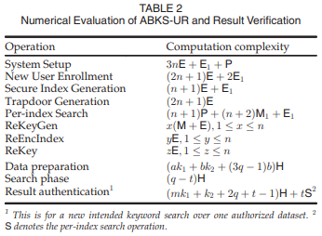
Performance
Supposedly Comparing ABKS-UR to APKS
Enron Email dataset
Everything scales linearly

Slide 22
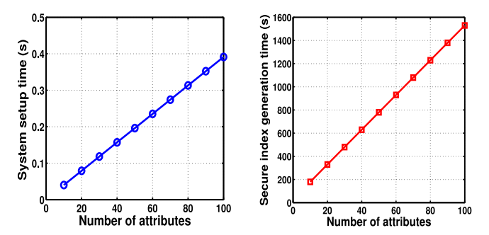
Performance
5 minutes to complete a search over 10,000 files with 30 attributes
Notes:
No hard performance numbers for user revocation

Slide 23
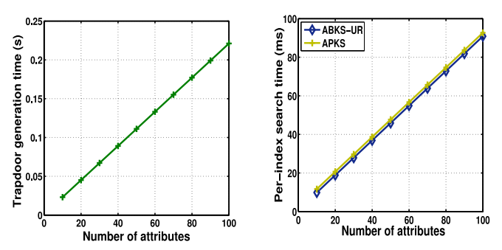
Performance

Slide 24
Questions?

